Slide 1
Microsoft Power BI

Slide 2
Power BI Embedding Best Practices with the Power BI JavaScript API
Ted Pattison
Principal Program Manager
Power BI Customer Advisory Team (PBICAT)

Slide 3
Welcome to Power BI Dev Camp
Power BI Dev Camp Portal - https://powerbidevcamp.net

Slide 4
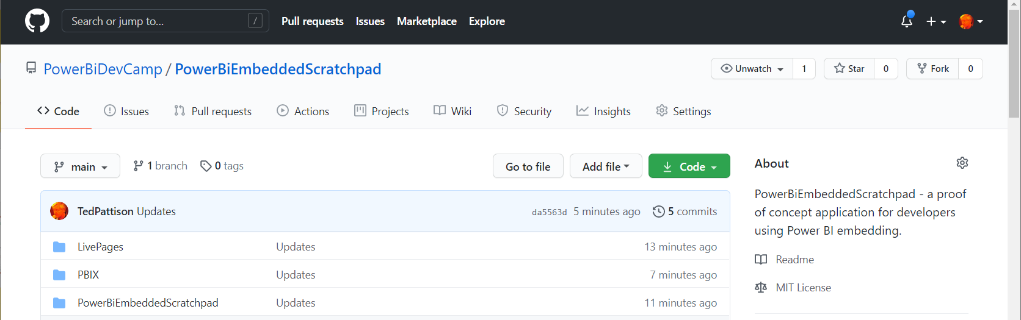
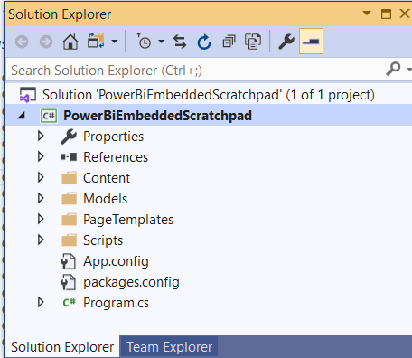
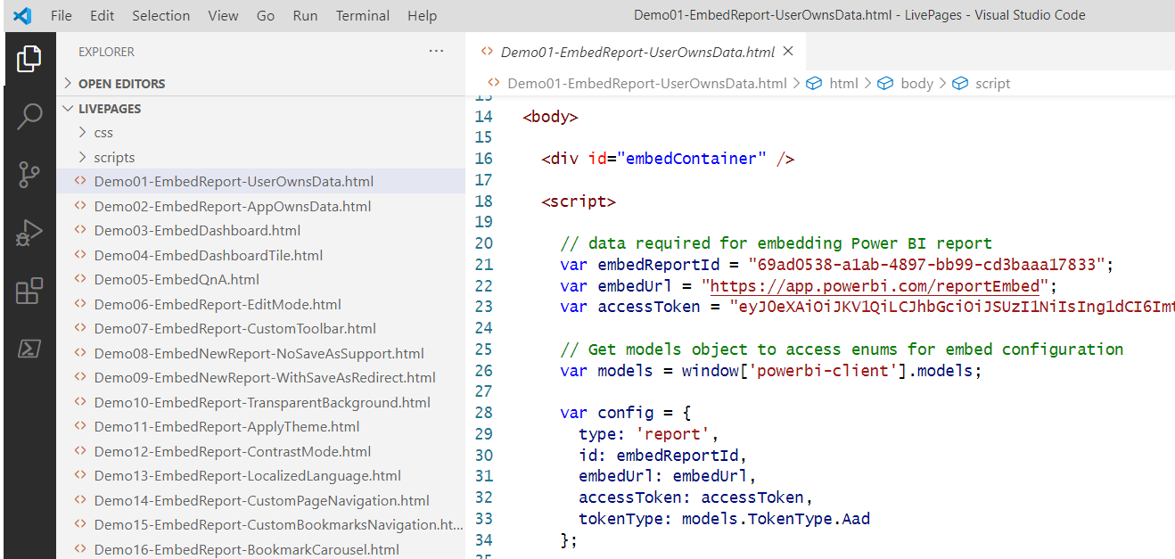
PowerBiEmbeddedScratchpad Sample Application
https://github.com/PowerBiDevCamp/PowerBiEmbeddedScratchpad
Running App Create Test Pages

Slide 5
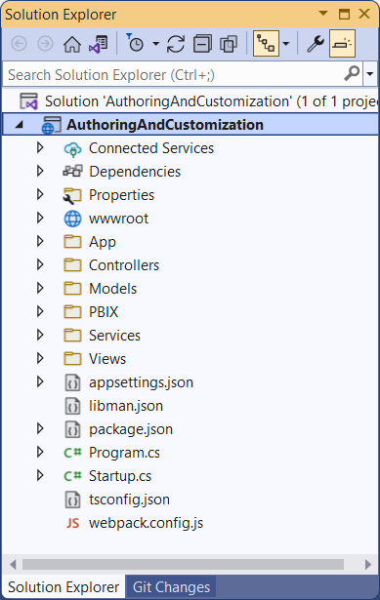
Developer Sample: AuthoringAndCustomization
Developer sample demonstrates App-Owns-Data embedding techniques
Implemented as C#/.NET6 web application which uses the Power BI .NET SDK
Download from https://github.com/PowerBiDevCamp/PBIE-Authoring-And-Customization
{F5}

Slide 6
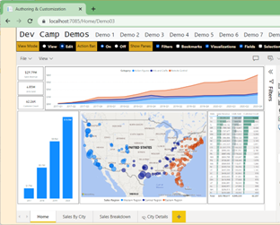
Developer Sample based on SPA Architecture
Each AuthoringAndCustomization demo page runs as a Single Page Application (SPA)
HomeController returns HTML for each page along with JavaScript viewModel with embedding data
Some demo pages require Web API callbacks after initial page has loaded
Demo08 includes Web API callbacks that read and write to underlying SQL database
CAVEAT: This is a proof-of-concept (POC) application with no user authentication or authorization
HomeController
EmbedTokenController
Bookmarks Controller
AppOwnsDataCustomizationDB

Slide 7
Agenda
Power BI Embedding Fundementals
Building Interactive Experiences
Programming with Report Events
Customizing Report Layouts
Creating Custom Navigation with Pages and Bookmarks
Creating Authoring Experiences with the Report Designer
Embedding Reports using Custom Layouts
Adding Personalization Features using Custom Bookmarks

Slide 8
Power BI Embedding – The Big Picture
User launches your app using a browser
App authenticates with Azure Active Directory and obtains access token
App uses access token to call to Power BI Service API
App retrieves data for embedded resource and passes it to browser.
Client-side code uses Power BI JavaScript API to create embedded resource
Embedded resource session created between browser and Power BI service
5
Power BI Service
Browser
iFrame
6
4
4
3
1
Your App
2
Azure AD

Slide 9
Power BI JavaScript API (powerbi.js)
Power BI JavaScript API used to embed resources in browser
Client-side JavaScript API required to develop with Power BI embedding
Documentation is titled Power BI embedded analytics Client APIs https://docs.microsoft.com/en-us/javascript/api/overview/powerbi/

Slide 10
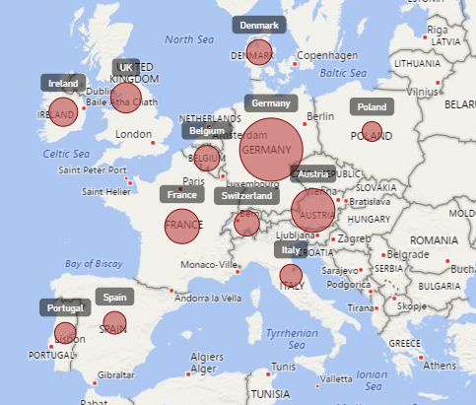
Report Embedding Architecture
Embedding involves creating an iFrame on the page
PBIJS transparently creates iFrame and sets source to Power BI Service
The iFrame and hosting page originate from different DNS domains
https://app1.mydomain.com
Your HTML and CSS
Web Hosting Server
Your
JavaScript
iFrame
Embedding Data
https://wabi-us-east2-redirect.analysis.windows.net/
powerbi.js
Power BI Service

Slide 11
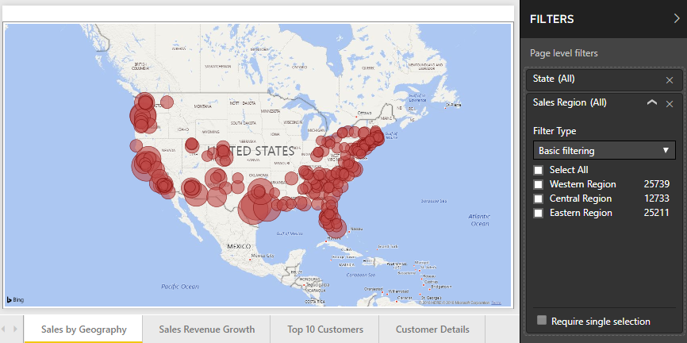
A Promise-based Programming Model
Design of PBIJS simulates HTTP protocol
Creates more intuitive programming model for developers
Programming based on asynchronous requests and promises
Embedded objects programmed using actions and events
Actions
report.fullscreen
report
report.switchMode
report.setFilters
Your
JavaScript
report.getPages
Events
report.loaded
report.pageChanged
report.commandTriggered

Slide 12
User-Owns-Data Embedding vs App-Owns-Data Embedding
User-Owns-Data Embedding
All users require a Power BI license
Useful in corporate environments
App authenticates as current user
Your code runs with user’s permissions
User’s access token passed to browser
App-Owns-Data Embedding
No consumers require Power BI license
Useful for commercial applications
App authenticates with app-only identity
Your code runs with admin permissions
Embed token passed to browser
User-Owns-Data Embedding for use within Organization
App-Owns-Data Embedding for use by ISVs
Browser
Power BI Service
Browser
Power BI Service
iFrame
Azure AD
Access Token
for the current user
iFrame
Power BI
Embed Token
for specific report

Slide 13
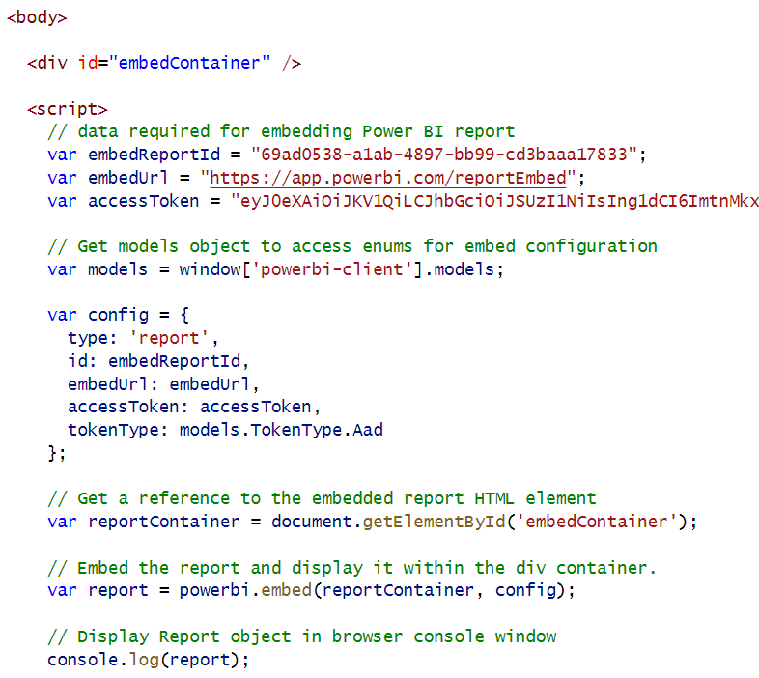
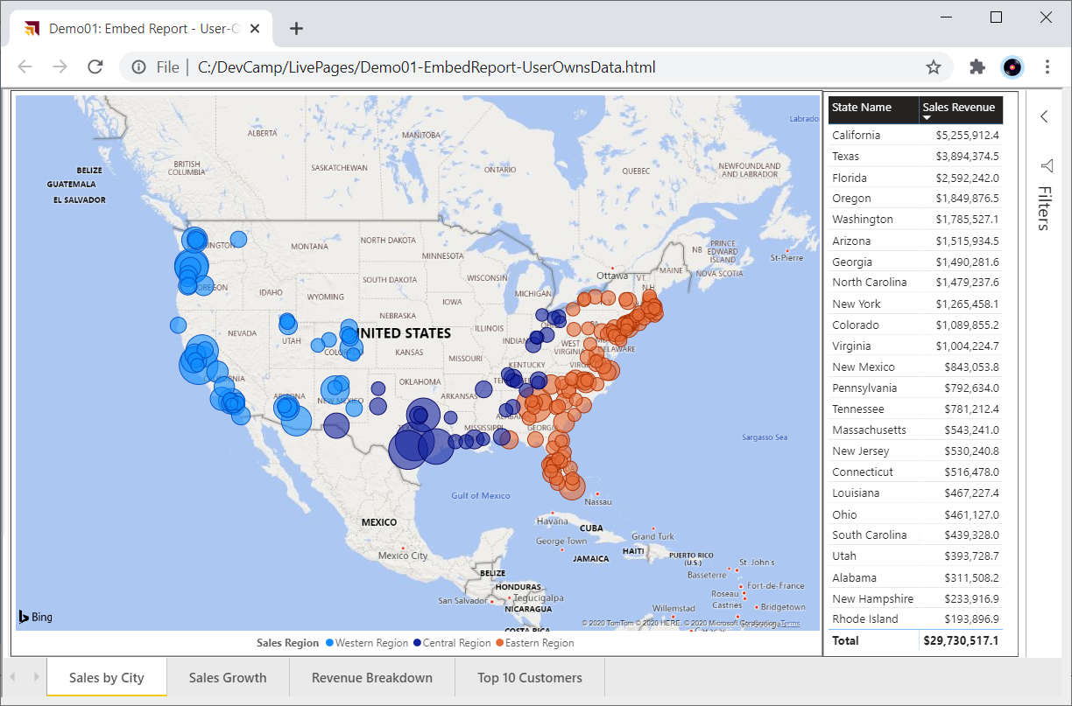
User-Owns-Data Embedding

Slide 14
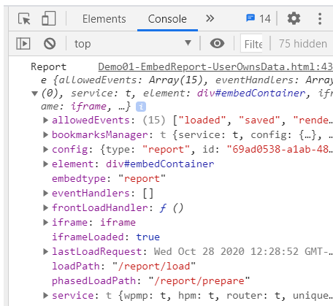
Viewing Report Object in Chrome Dev Tools

Slide 15
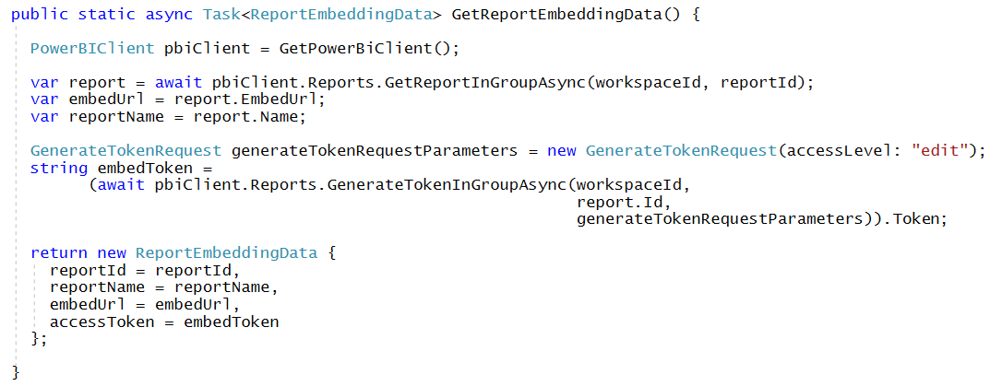
Getting the Data for App-Owns-Data Report Embedding

Slide 16
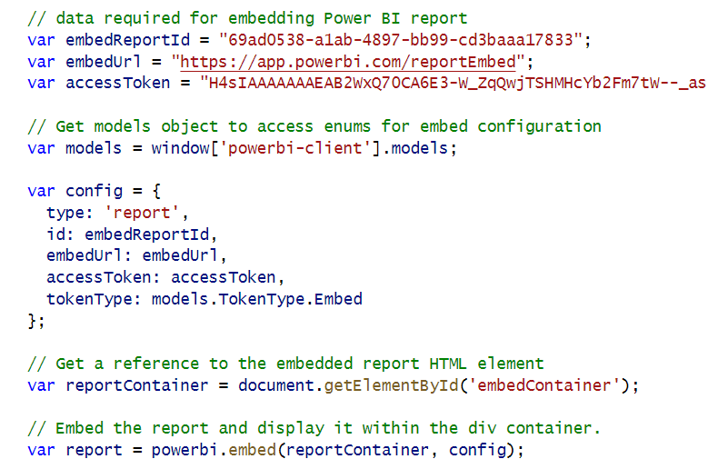
App-Owns-Data Embedding

Slide 17
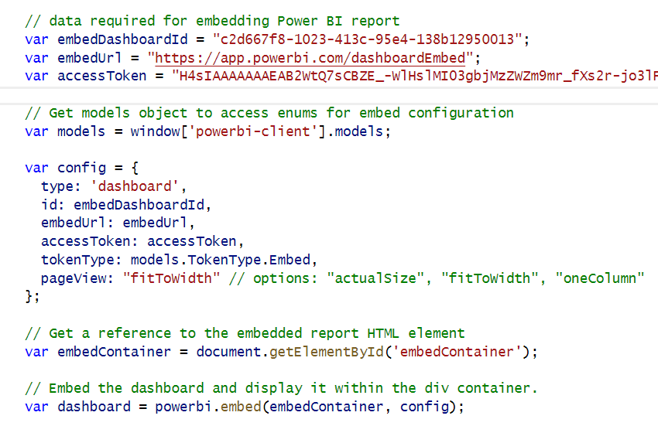
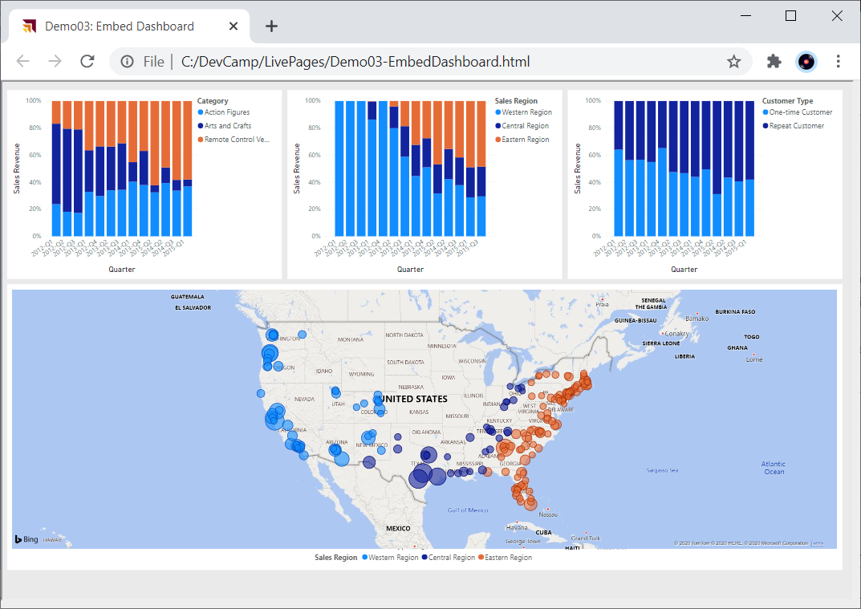
Embedding a Dashboard

Slide 18
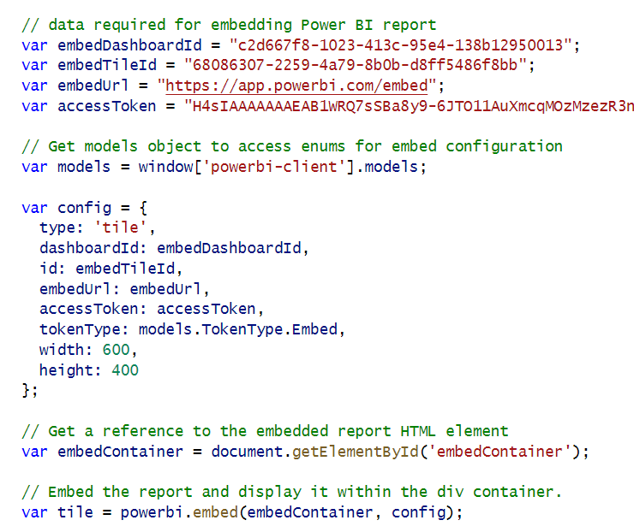
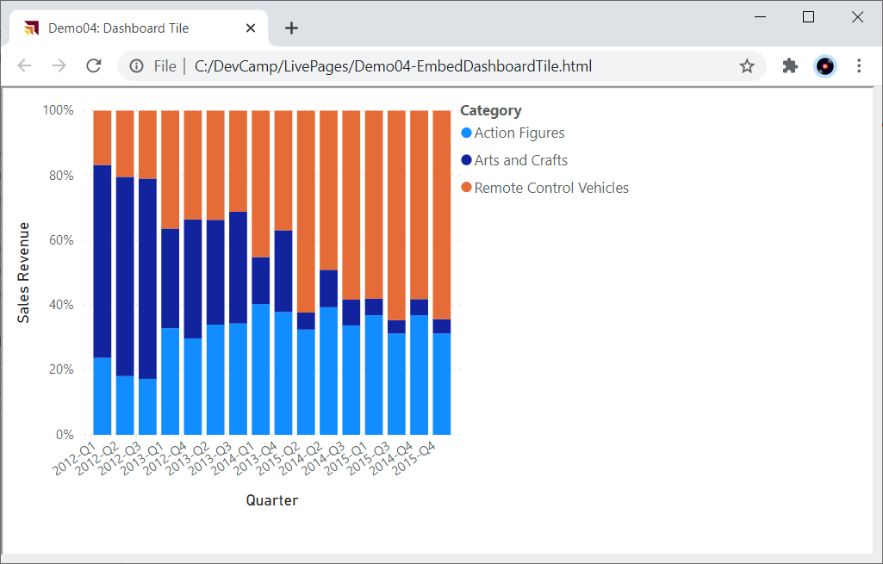
Embedding a Dashboard Tile

Slide 19
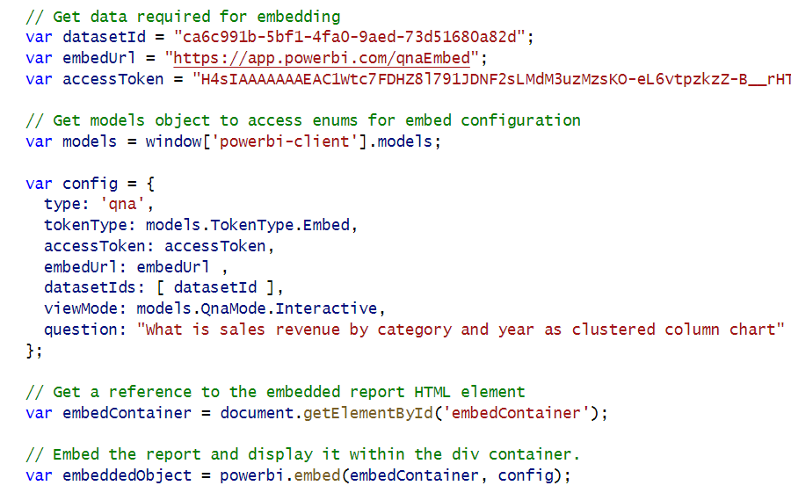
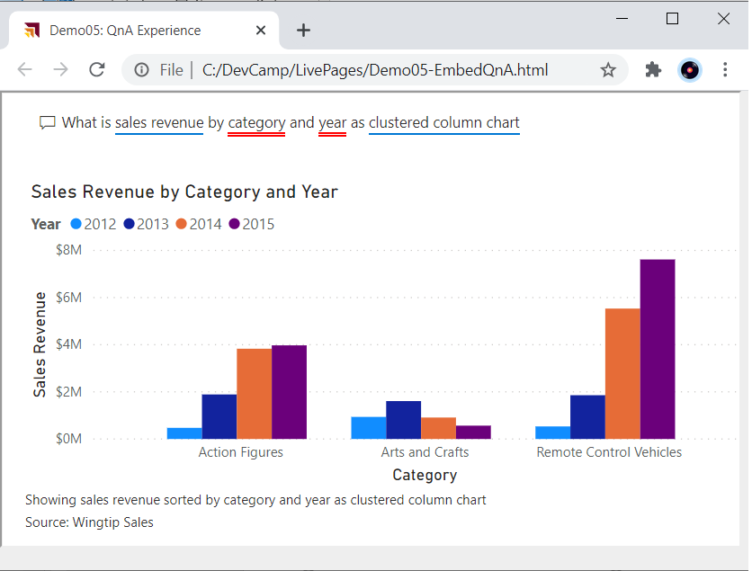
Embedding the QnA Experience

Slide 20
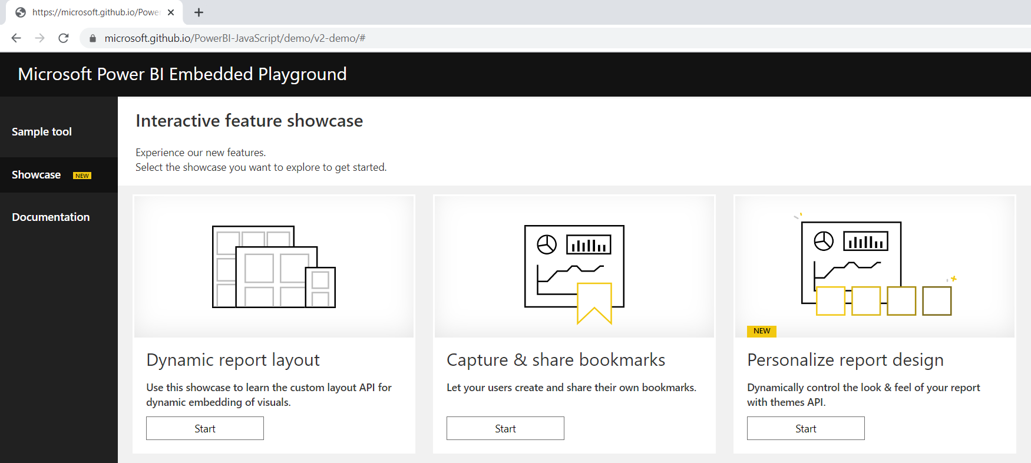
Power BI Embedded Playground
https://microsoft.github.io/PowerBI-JavaScript/demo/v2-demo/#

Slide 21
Programming the powerbi.js library using TypeScript
You can write code which programs with powerbi.js using JavaScript or TypeScript
Using TypeScript adds strongly-typed programming and much better IntelliSense
AuthoringAndCustomization project maintains TypeScript code in App folder
TypeScript code in project is compiled into JavaScript using webpack
webpack compilation

Slide 22
Hello World with powerbi.js using TypeScript
Demo01
Let's walkthrough the code in App01.ts
UIBuilder is a simple utility class which handles resizing the embed-container DIV and adding HTML elements and command handlers into the application's user interface

Slide 23
Viewing Report Object in Chrome Dev Tools
Demo01

Slide 24
Exploring powerbi.js Events
Demo01
Demo01 registers event handlers for all supported powerbi.js events
Use it to gain understanding of which user actions trigger specific events
Event arguments logged to console window for easy inspection

Slide 25
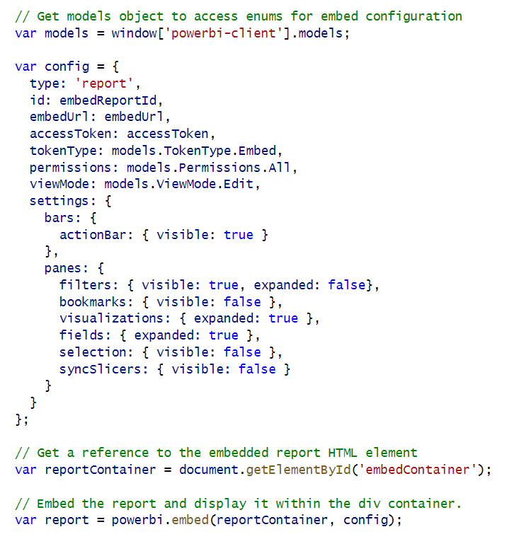
Initializing Panes When Embedding a Report
Demo02
Report panes and action bar can be set in config object
Filter pane and Bookmarks pane are only panes available in View mode
Other panes are only available when report is in Edit mode

Slide 26
Showing and Hiding Report Panes in View Mode
Demo02
You can hide and show panes after report has loaded using code
Show/Hide Filters Pane
Show/Hide Bookmarks Pane

Slide 27
Updating the Display Option Setting
Demo02
Display Option for report pages can be set to Fit To Page | Fit To Width | Actual Size
Display Option set to Fit To Page by default
Report settings for page displayOption must be updated using customLayout setting
Switch report to Fit to Page
Switch report to Fit to Screen
Switch report to Actual size

Slide 28
Agenda
Initializing and Customizing Report Pages
Creating Custom Navigation with Pages and Bookmarks
Creating Authoring Experiences with the Report Designer
Creating New Pages and Adding Visuals using Code
Embedding Reports using Custom Layouts
Adding Personalization Features using Custom Bookmarks

Slide 29
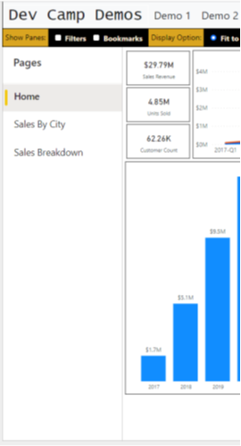
Report Navigation Settings
Demo02
You can show or hide page-based navigation menu used in Power BI Service
Page navigation can be shown on left side of page or bottom of page
set navigation
left navigation
bottom navigation

Slide 30
Creating a Custom Navigation Scheme
Demo02
Custom Navigation can be added using pages or bookmarks

Slide 31
Agenda
Initializing and Customizing Report Pages
Creating Custom Navigation with Pages and Bookmarks
Creating Authoring Experiences with the Report Designer
Creating New Pages and Adding Visuals using Code
Embedding Reports using Custom Layouts
Adding Personalization Features using Custom Bookmarks

Slide 32
Moving a Report into Edit Mode
Demo03
Report can be opened in Edit mode or switched into Edit mode after opening
Minimal code required to switch report into Edit mode
For user to perform Save operation, embed token must have reportId with allowEdit set to true
For user to perform Save As operation, embed token must include workspaceId

Slide 33
GetReportEmbeddingData
Demo03

Slide 34
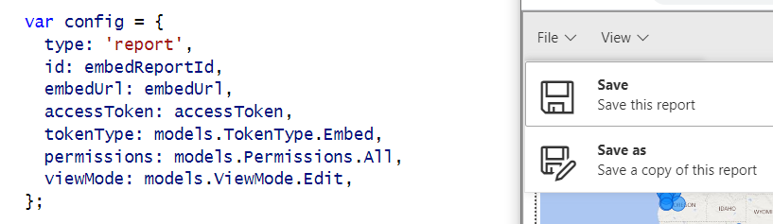
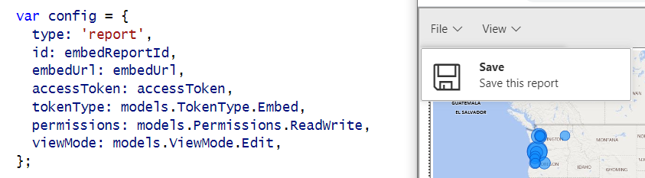
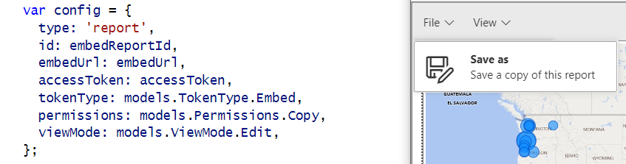
Showing and Hiding the Save and Save as Menus
Demo03
permissions: models.Permissions.All
permissions: models.Permissions.ReadWrite
permissions: models.Permissions.Copy

Slide 35
Implementing the Save-As Redirect
Demo03
saved event fires on both Save and SaveAs actions.
Call to EmbedTokenController Web API to get new embed token with the report ID of the new report

Slide 36
EmbedTokenController Calls GetEmbedToken
Demo03
SaveAs Redirect includes Web API callback to EmbedTokenController
Implemented using jQuery $.ajax() call to EmbedTokenController
Web API call to get updated embed token
Web API call
call to GetEmbedToken

Slide 37
GetEmbedToken
Demo03
Create token request object collections
add IDs for workspaces
add all dataset IDs from source workspace
add all report IDs from source workspace
add all report IDs from target workspace
Create GenerateTokenRequestV2 object
Call Power BI REST API to generate token
Return token to caller as a string

Slide 38
Using a Custom SaveAs Dialog
Demo04
Power BI embedding supports using custom Save As dialog
saveAsTriggered event fires when user in selects Save As command from action bar
Your code must display custom dialog and then execute report.SaveAs

Slide 39
Saving Copy of Report to a Target Workspace
Demo04
When calling report.SaveAs, you can specify a target workspace
Customized reports can be saved and maintained in different workspaces
Embed token requires workspace ID for target workspace

Slide 40
Agenda
Initializing and Customizing Report Pages
Creating Custom Navigation with Pages and Bookmarks
Creating Authoring Experiences with the Report Designer
Creating New Pages and Adding Visuals using Code
Embedding Reports using Custom Layouts
Adding Personalization Features using Custom Bookmarks

Slide 41
Adding the powerbi-report-authoring Library
Demo05
Report authoring features not included with standard powerbi.js library
Add powerbi-report-authoring package to project for authoring features
Add import statement for powerbi-report-authoring to use authoring feature
Importing powerbi-report-authoring extends Report object with new methods
CAVEAT: As of April 2022, authoring features only supported for existing Report objects
Adding authoring features for Create objects (i.e. new reports) is currently a backlog item

Slide 42
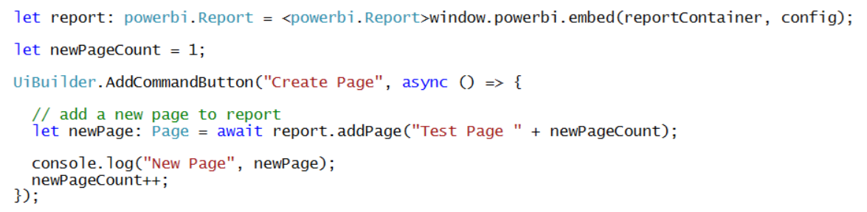
Adding a Page to a Report
Demo05
The code to add a new page is very simple

Slide 43
Understanding Visual Capabilities and Data Roles
Demo05
Visual capabilities can be queried to determine data roles
Data roles allow user to configure visual with fields from data model

Slide 44
Defining Targets for Columns and Measures
Demo05
Adding fields to data roles requires creation of column targets and measure targets
Example of creating a visual and adding target columns and measures to data roles

Slide 45
Creating a Table Visual
Demo05

Slide 46
Create a Column Chart Visual
Demo05

Slide 47
Create a Map Visual
Demo05

Slide 48
Visual Types Available for Programmatic Creation
Demo05
actionButton
areaChart
barChart
basicShape
card
clusteredBarChart
clusteredColumnChart
columnChart
debugVisual
Decomposition Tree
donutChart
esriVisual
filledMap
funnel
gauge
hundredPercentStackedBarChart
hundredPercentStackedColumnChart
image
keyDriversVisual
kpi
lineChart
lineClusteredColumnComboChart
lineStackedColumnComboChart
map
multiRowCard
pieChart
pivotTable
PowerApps
pythonVisual
qnaVisual
ribbonChart
scatterChart
scriptVisual
shapeMap
slicer
stackedAreaChart
tableEx
textbox
treemap
waterfallChart

Slide 49
Agenda
Initializing and Customizing Report Pages
Creating Custom Navigation with Pages and Bookmarks
Creating Authoring Experiences with the Report Designer
Creating New Pages and Adding Visuals using Code
Embedding Reports using Custom Layouts
Adding Personalization Features using Custom Bookmarks

Slide 50
Getting the Names of Pages and Visuals
Demo06
You can discover page names and visual names using Demo01 events explorer
In some scenarios, you might want to hard-code page and visual names into your code

Slide 51
Creating a Static Custom Layout
Demo06
You can set x position, y position, width and height for each visual in a custom layout

Slide 52
Creating a Custom Layout without Hard-coded IDs
Demo06

Slide 53
Displaying a Single Visual
Demo06
Create a custom layout that only display a single visual
Visual can be sized to full width and height of report
Use defaultLayout to hide all other visuals by default.

Slide 54
Agenda
Initializing and Customizing Report Pages
Creating Custom Navigation with Pages and Bookmarks
Creating Authoring Experiences with the Report Designer
Creating New Pages and Adding Visuals using Code
Embedding Reports using Custom Layouts
Adding Personalization Features using Custom Bookmarks

Slide 55
Adding Custom Navigation using Bookmarks
Demo07
Let's start by adding navigation using bookmarks defined inside the report

Slide 56
Capturing a Custom Bookmark
Demo07

Slide 57
Demo08 demonstrates persisting bookmarks in database
Application design support Shared Bookmarks and Personal Bookmarks
Shared bookmark seen by all report consumers
Personal bookmark only seen by user that created it
Bookmarks Controller
SharedBookmarks
table
PersonalBookmarks
table

Slide 58
Tables for Persisting Custom Bookmarks
SharedBookmarks table
PersonalBookmarks table

Slide 59
Loading with Persisted Bookmarks
Demo08

Slide 60
Adding Personalized Report Subscriptions
Demo08
With App-Owns-Data embedding, Power BI does not know user identity
App-Owns-Data embedding does not provide SaaS-style personalization features
Personalization features must be fully implemented by developer
Let's explore application design to support personalized report subscriptions
Start by allow users to save subscription information to ReportSubscriptions table
Implement subscriptions service to read to ReportSubscriptions table and export reports
PDF files for exported reports can be sent to users via email attachment

Slide 61
Summary
Initializing and Customizing Report Pages
Creating Custom Navigation with Pages and Bookmarks
Creating Authoring Experiences with the Report Designer
Creating New Pages and Adding Visuals using Code
Embedding Reports using Custom Layouts
Adding Personalization Features using Custom Bookmarks

Slide 62
Microsoft Power BI
Questions?

Slide 63
Agenda
Power BI Embedding 101
Building Interactive Experiences
Programming with Report Events
Customizing Report Layouts
Advanced Embedding Topics
SPA Architecture with MSAL.JS

Slide 64
Agenda
Power BI Embedding 101
Building Interactive Experiences
Programming with Report Events
Customizing Report Layouts
Advanced Embedding Topics
SPA Architecture with MSAL.JS

Slide 65
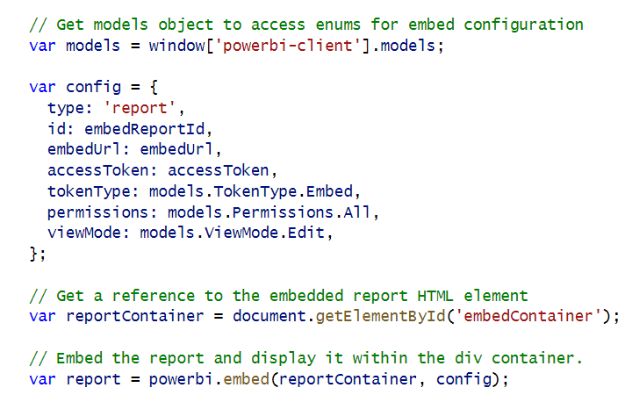
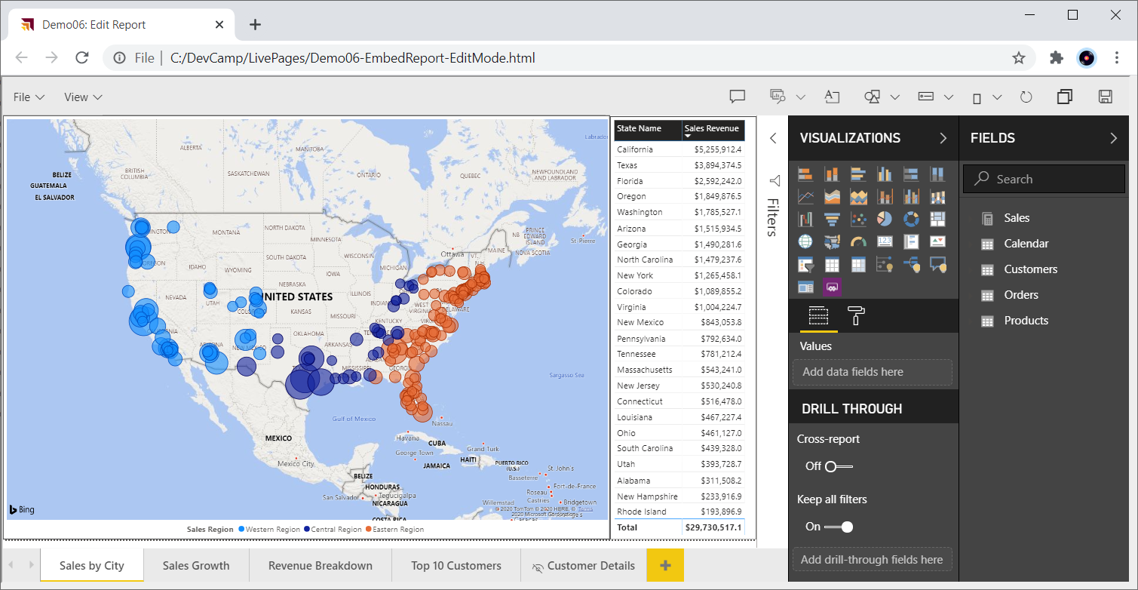
Embedding Reports in Edit Mode

Slide 66
Report Panes

Slide 67
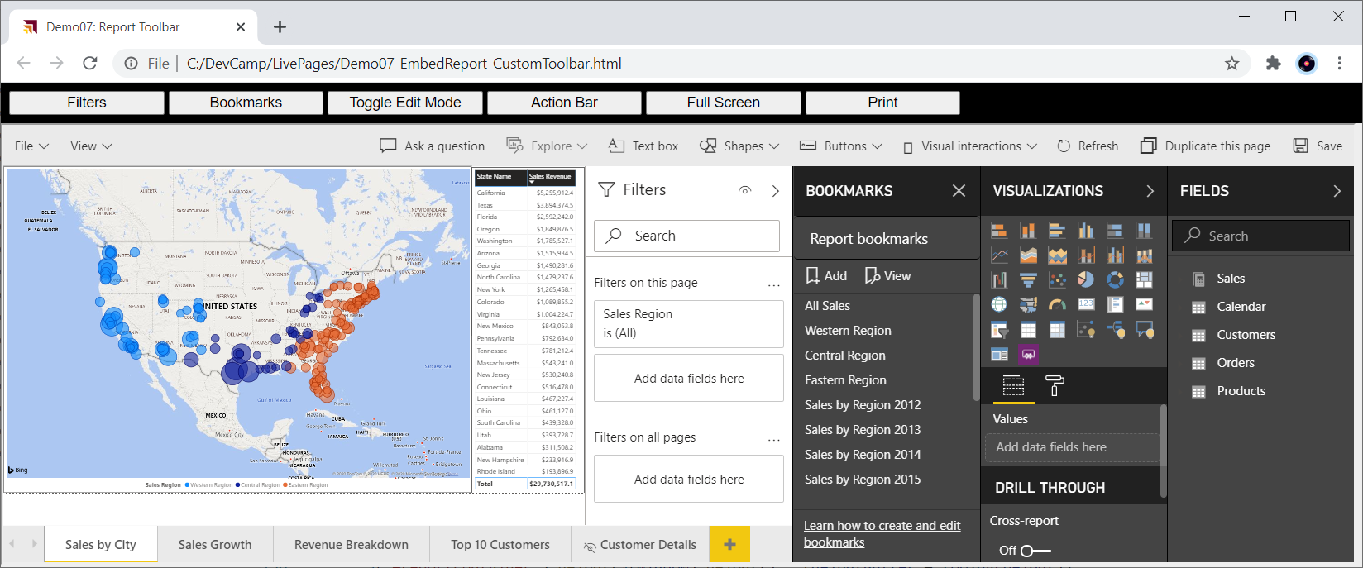
Embedding with a Custom Toolbar

Slide 68
Showing and Hiding the Save and Save as Menus
permissions: models.Permissions.All
permissions: models.Permissions.ReadWrite
permissions: models.Permissions.Copy

Slide 69
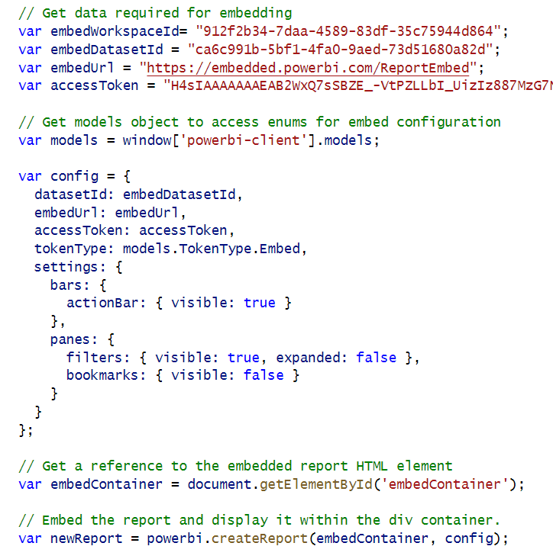
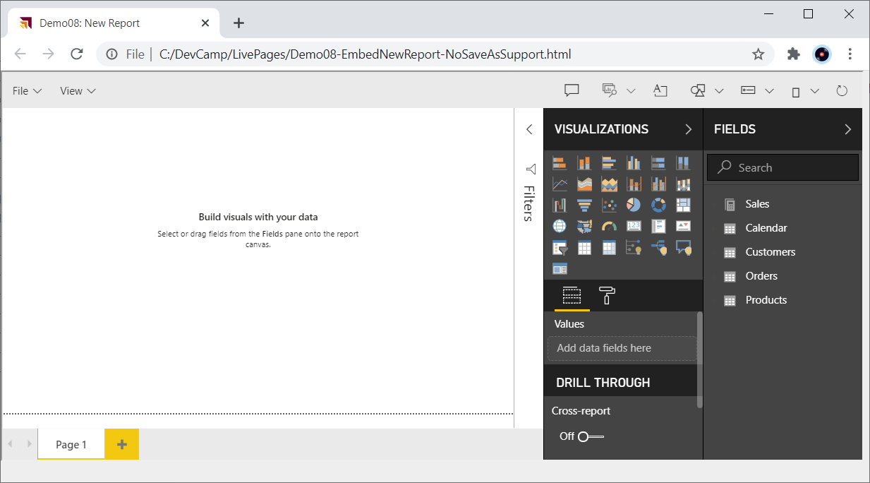
Embed a New Report

Slide 70
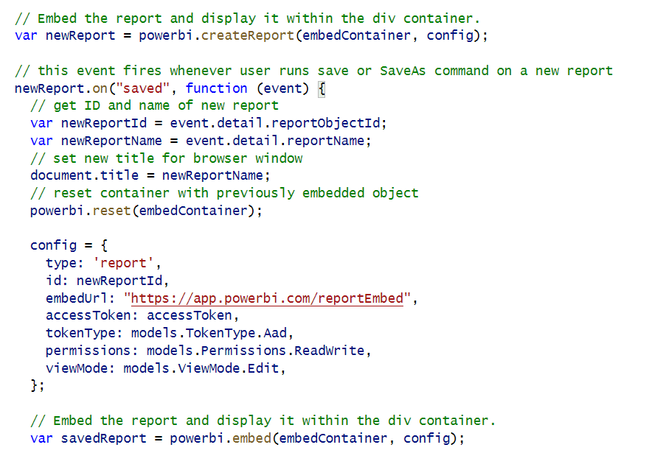
New Report with Save As Redirect

Slide 71
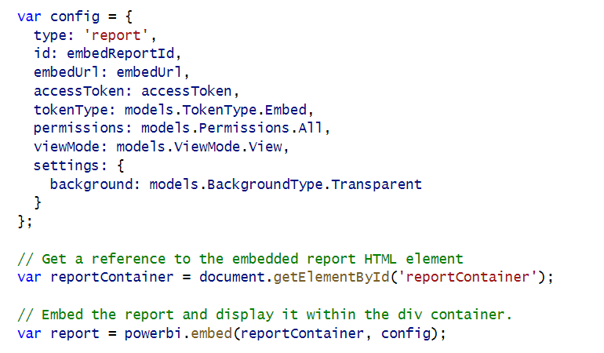
Embed Report with Transparent Background

Slide 72
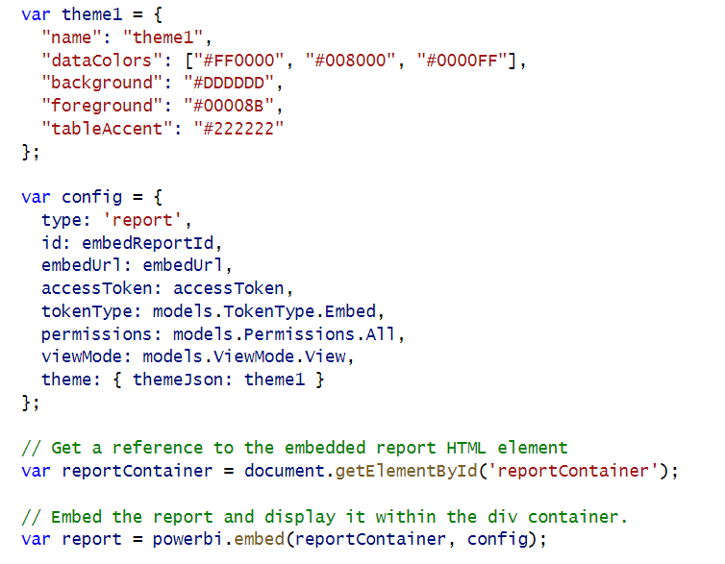
Applying Report Themes

Slide 73
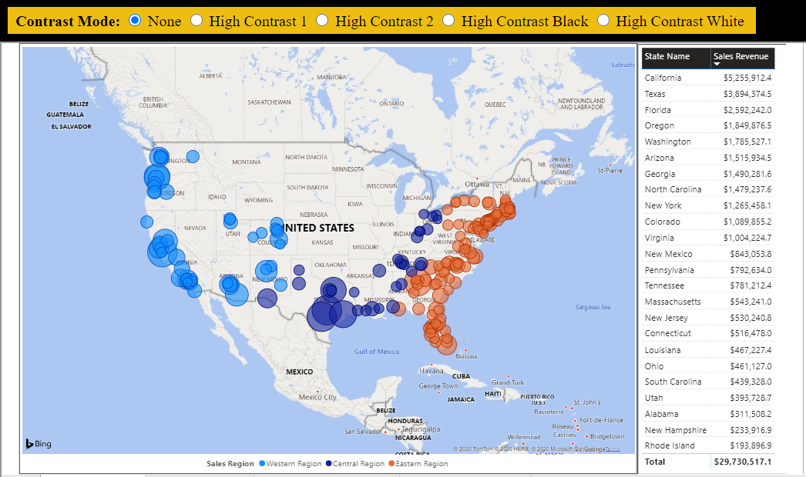
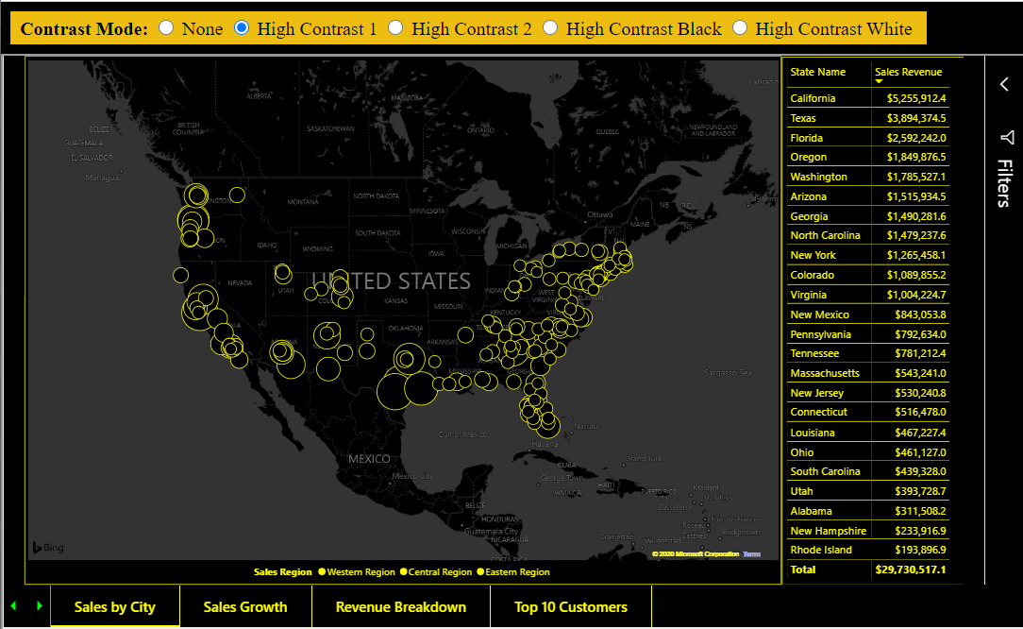
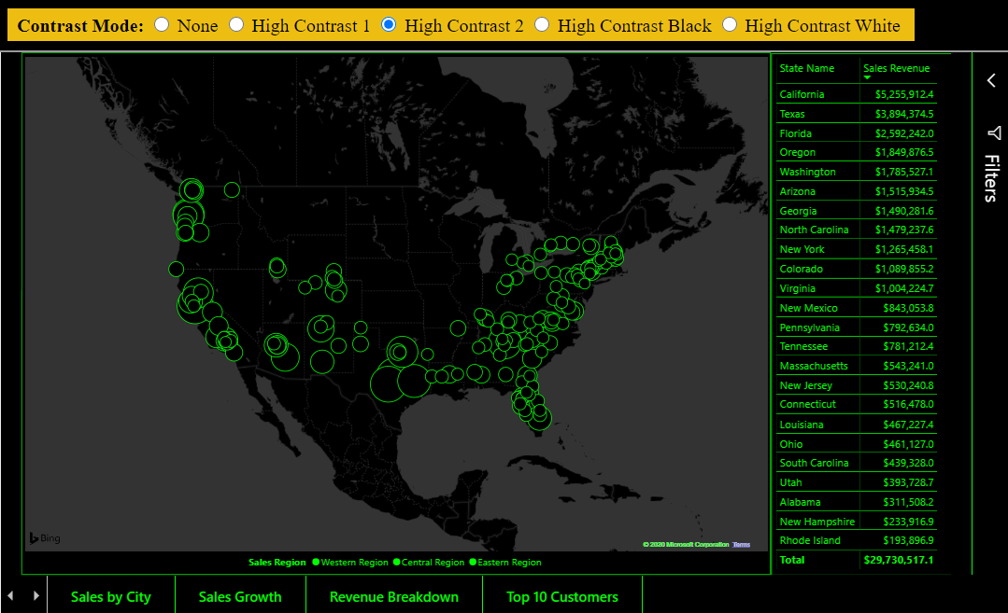
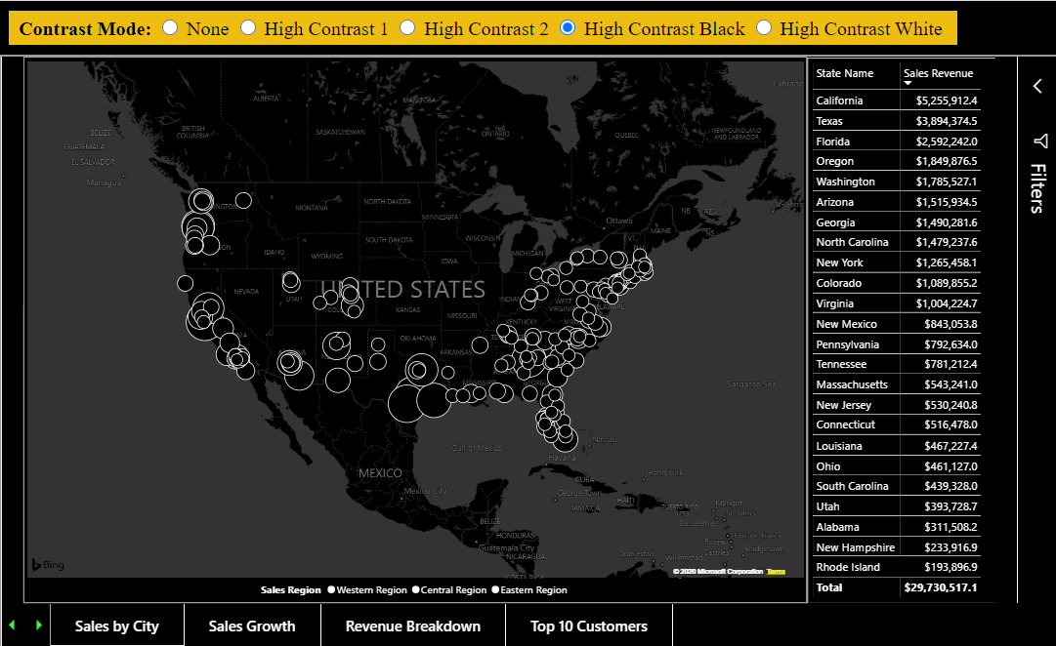
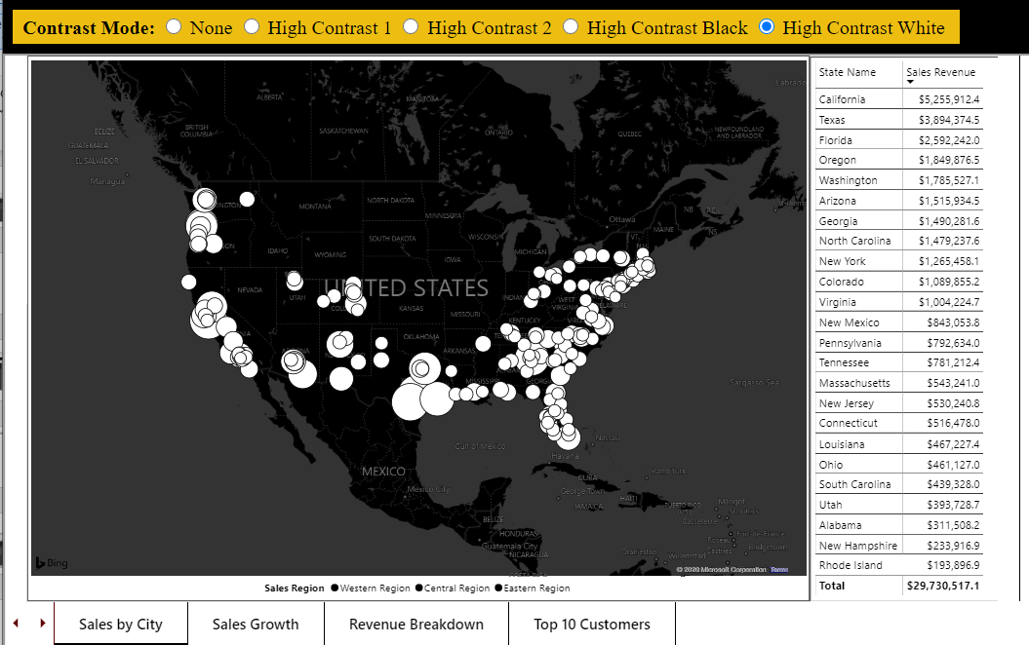
Contrast Mode

Slide 74
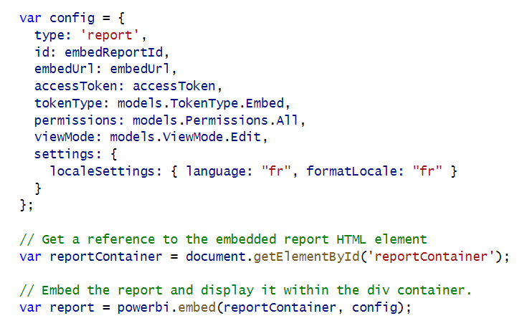
Loading Reports with Localized Languages

Slide 75
Agenda
Power BI Embedding 101
Building Interactive Experiences
Programming with Report Events
Customizing Report Layouts
Advanced Embedding Topics
SPA Architecture with MSAL.JS

Slide 76
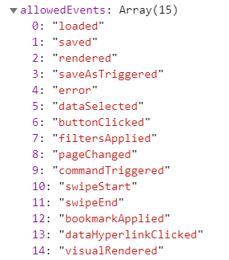
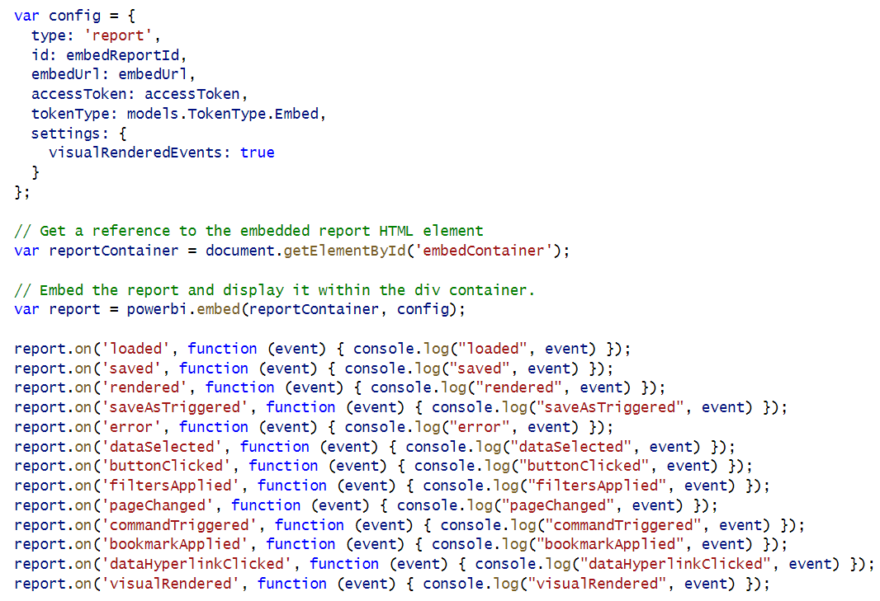
Report Allowed Events

Slide 77
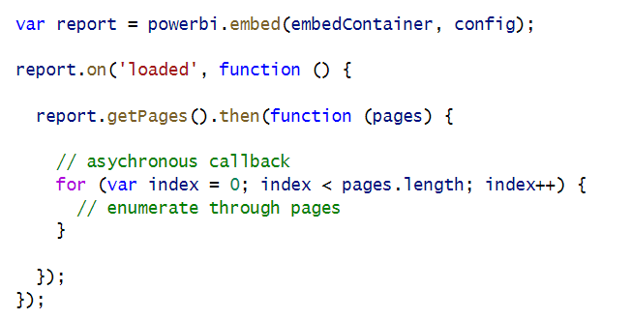
Calling report.getPages() in the loaded event

Slide 78
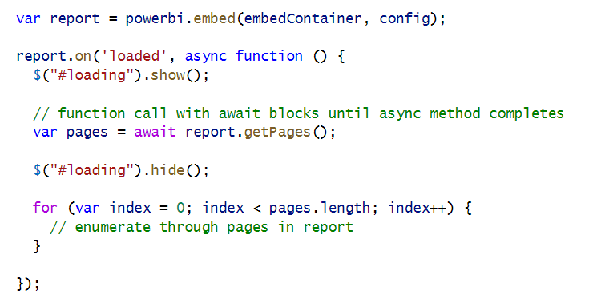
Using async and await keywords in JavaScript

Slide 79
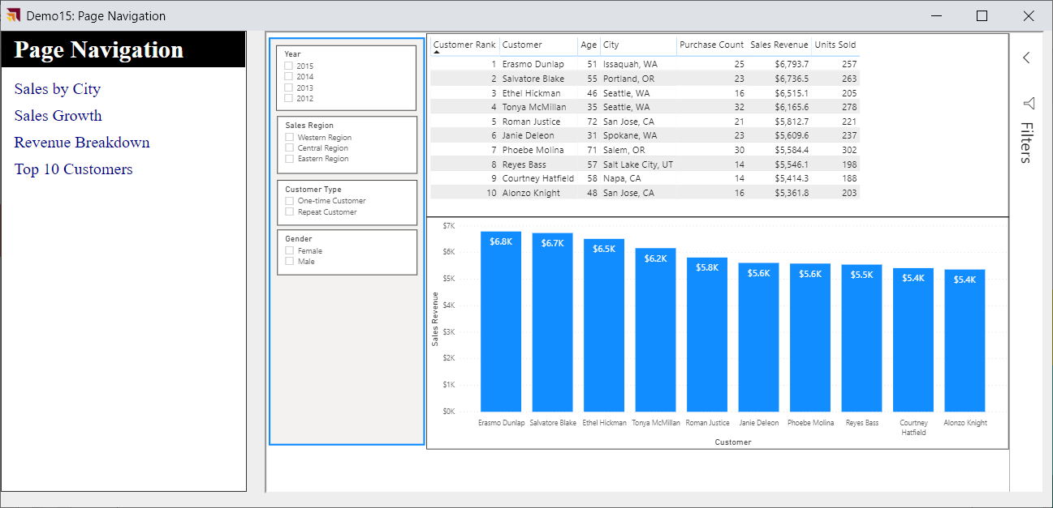
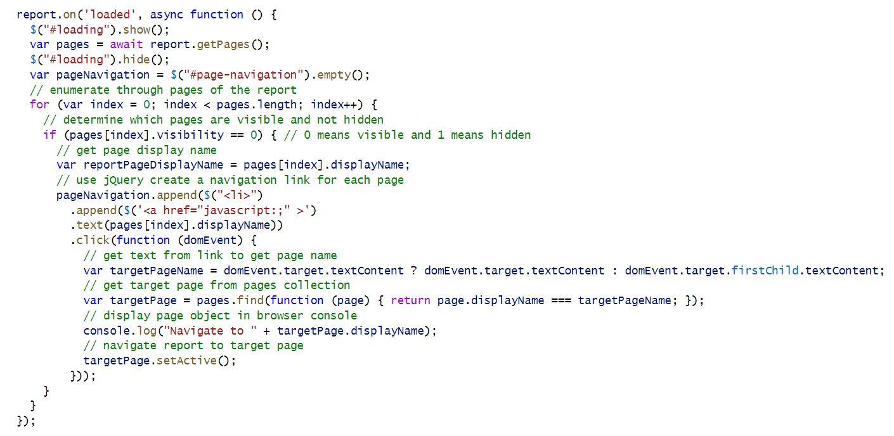
Custom Page Navigation

Slide 80
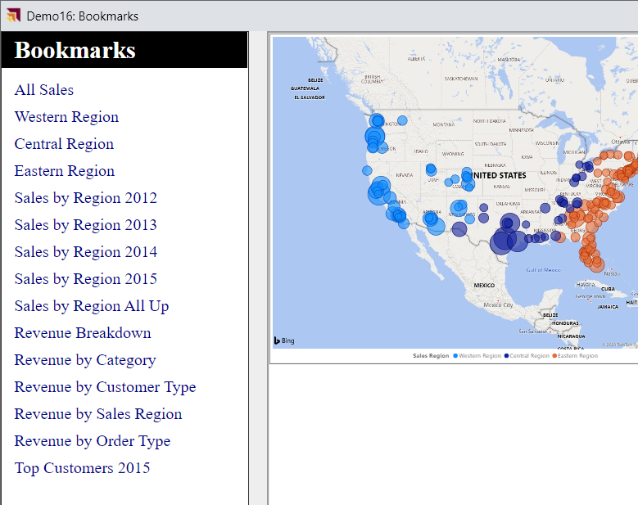
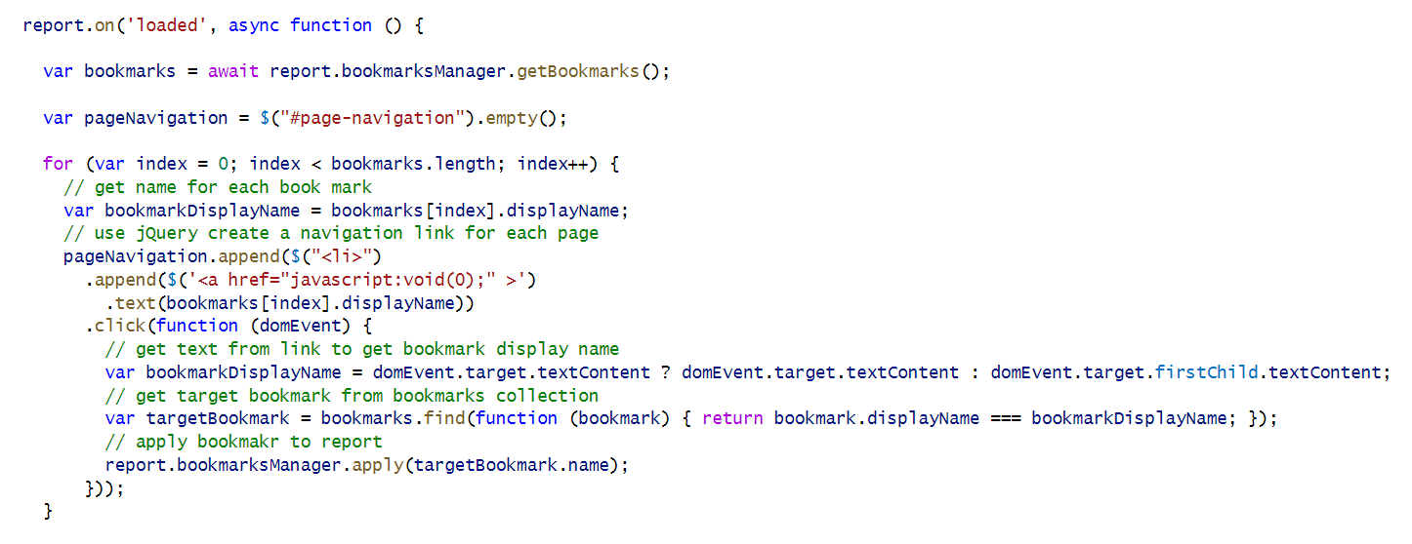
Custom Bookmark Navigation

Slide 81
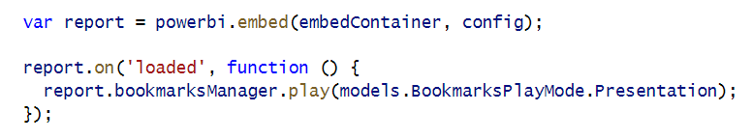
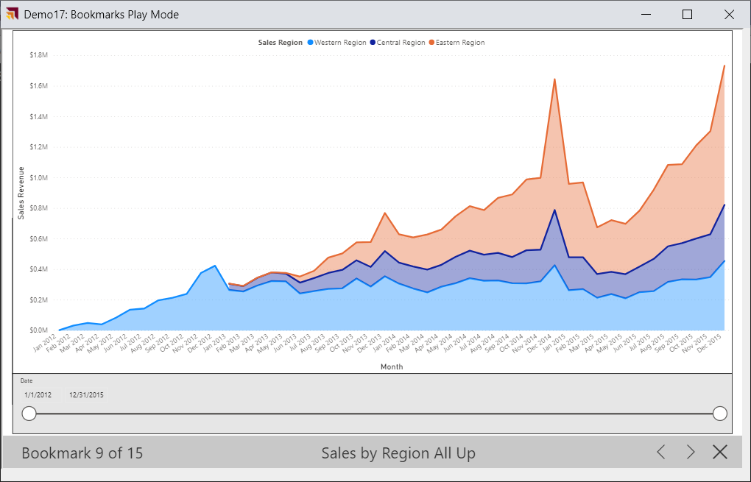
Bookmark Play Mode

Slide 82
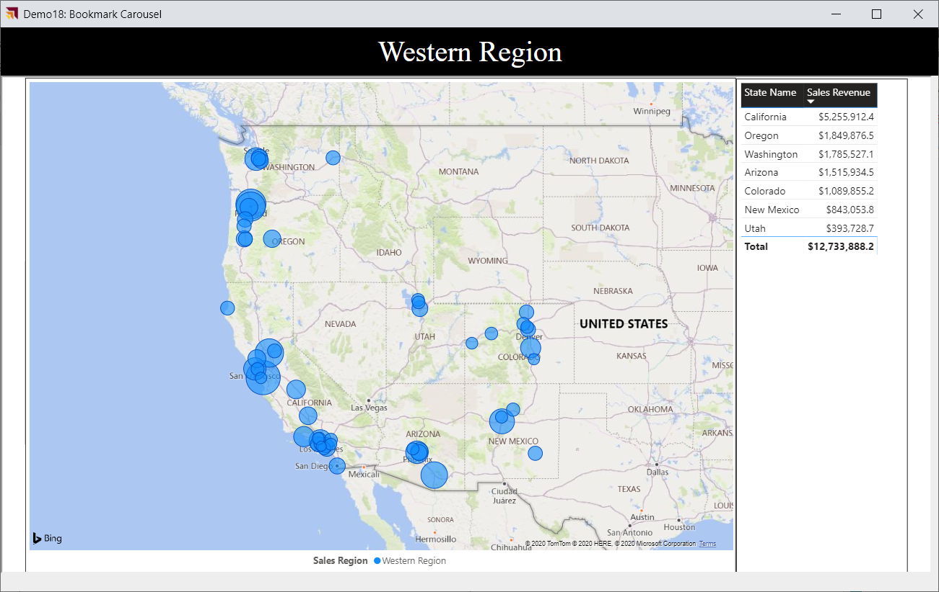

Bookmark Carousel

Slide 83


Implementing a Custom Filtering Experience

Slide 84

Phased Embedding

Slide 85


White Label Report Loading

Slide 86

Bootstrap Optimization in Report Loading

Slide 87


Adding Visual Menu Commands

Slide 88

Hiding Built-in Visual Menu Commands

Slide 89


Create a Custom Visual Export Command

Slide 90
Agenda
Power BI Embedding 101
Building Interactive Experiences
Programming with Report Events
Customizing Report Layouts
Advanced Embedding Topics
SPA Architecture with MSAL.JS

Slide 91


Determining Visual Names with Visual Inspector

Slide 92

Embedding a Single Visual
Limit this to one visual embed per page – it really embeds the whole report then shows one visual

Slide 93

Custom Report Page Layouts

Slide 94
Agenda
Power BI Embedding 101
Building Interactive Experiences
Programming with Report Events
Customizing Report Layouts
Advanced Embedding Topics
SPA Architecture with MSAL.JS

Slide 95


Generating Embed Tokens with EffectiveIdentity

Slide 96

Auditing App-Owns-Data User with Correlation ID
Problem: apps-owns-data does add username to PBI audit logs
Solution: develop custom logging scheme with correlation ID

Slide 97


Dynamic Dataset Binding

Slide 98

Authoring Pages and Visuals using Code
https://github.com/microsoft/powerbi-report-authoring/wiki

Slide 99
Agenda
Power BI Embedding 101
Building Interactive Experiences
Programming with Report Events
Customizing Report Layouts
Advanced Embedding Topics
SPA Architecture with MSAL.JS

Slide 100

Sample Application - PowerBiEmbeddingSPA
https://github.com/PowerBiDevCamp/PowerBiEmbeddingSPA

Slide 101

Demo Time

Slide 102
Summary
Power BI Embedding 101
Building Interactive Experiences
Programming with Report Events
Customizing Report Layouts
Advanced Embedding Topics
SPA Architecture with MSAL.JS

